Slide 1
SOUTHEAST LAND SERVICES, LLC. 2404 HICKORY GROVE DRIVE MONROE, GEORGIA 30656 678.758.6293

Slide 2
ABOUT SOUTHEAST LAND SERVICES
Southeast Land Services, LLC. is a woman-owned small business offering a vast array of land services to the utility sector, municipalities and private developers. Collectively, Southeast Land Services members and management have over 50 years experience. Our TOP priority is to help our clients complete their projects SAFELY, ON-TIME and within BUDGET.

Slide 3
SERVICES WE OFFER
CLEARING, GRINDING, GRUBBING AND GRADING
CONSTRUCTION ENTRANCES, ACCESS ROADS AND PADS
DRAINAGE SOLUTIONS
EROSION CONTROL
FENCING
FORESTRY MULCHING
TEMPORARY AND PERMANENT GRASSING
STRAW BLOWING
SLOPE MATTING
DETENTION/RETENTION POND MAINTENANCE
RIGHT-OF-WAY RESTORATION AND MAINTENANCE
MOWING AND VEGETATION MANAGEMENT
PUNCHLIST COMPLETION
MARKER INSTALLATION
RIGHT-OF-WAY AND ENVIRONMENTAL INSPECTION
STREAMBANK RESTORATION
LEVEE CONSTRUCTION
STORM CLEANUP AND DEBRIS REMOVAL
MAT PLACEMENT FOR CONTRACTORS IN SENSITIVE AREAS
TELECOMMUNICATION INFRASTRUCTURE CONSTRUCTION

Slide 4
PERSONNEL
With 10-15 full time employees and a network of contract equipment operators and laborers, Southeast Land Services is capable of operating multiple crews at a time.
Usually each crew is comprised of a foreman, operator and multiple laborers depending on the size of the project.
Our superintendents work flow depends on the size of the project resulting in the superintendent either overseeing one larger project or several smaller projects at a time.
Southeast Land Services owners are hands-on and spend a lot of their time in the field monitoring crew production and quality of workmanship.

Slide 5
EQUIPMENT
SOUTHEAST LAND SERVICES UTILIZES AN ARRAY OF EQUIPMENT BOTH OWNED AND LEASED.
DOZERS, EXCAVATORS, LOADERS, MAROOKA’S AND OFF ROAD DUMP TRUCKS
FARM TRACTORS, MOWERS, TILLAGE AND SEEDING EQUIPMENT
FELLER BUNCHERS, SKIDDERS AND GRINDER
MARSH MASTER
UTV’S
DUMP, GOOSENECK AND UTILITY TRAILERS
LOG AND MULCH TRAILERS
1/2-1 TON PICKUPS

Slide 6
CUSTOMERS
We offer our services to a variety of clients including the energy sector, municipalities and private developers.
Some of our past and current clients include:

Slide 7
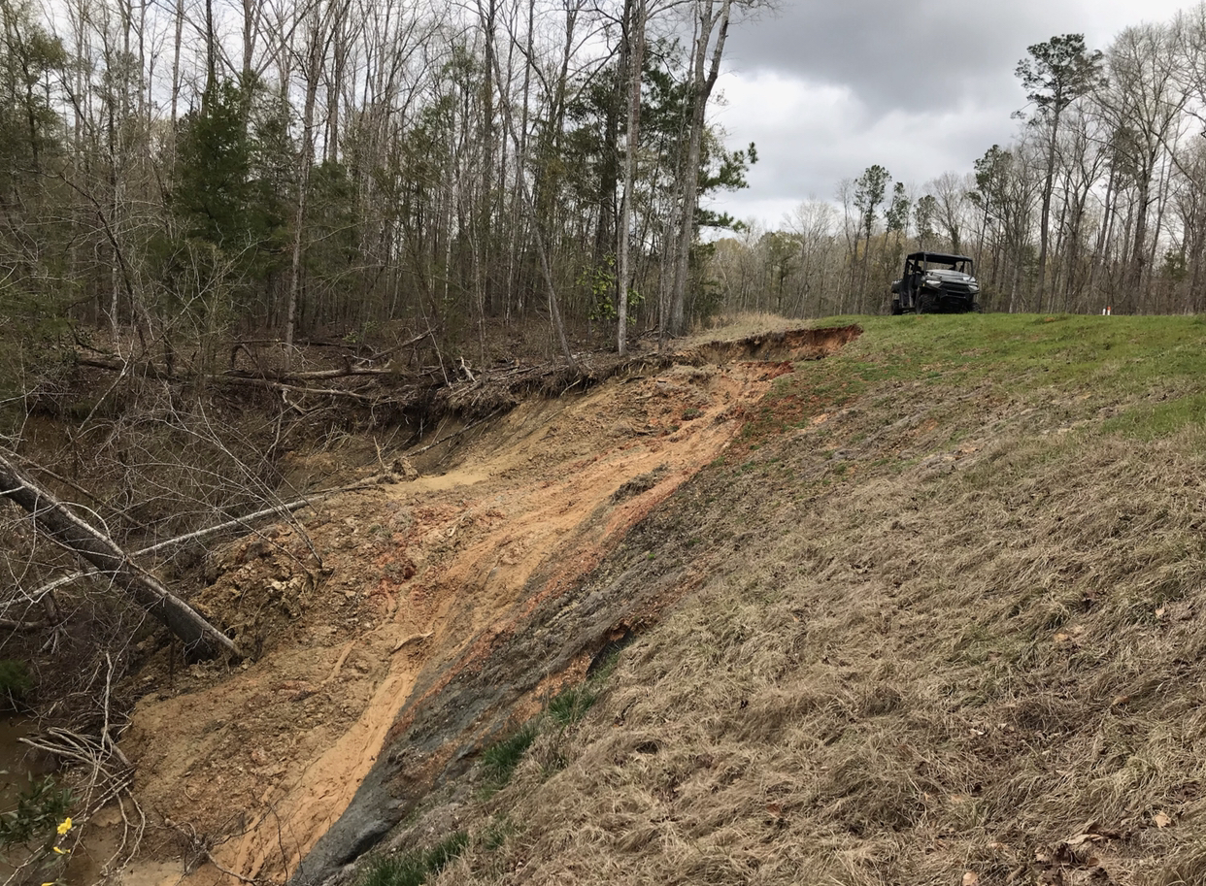
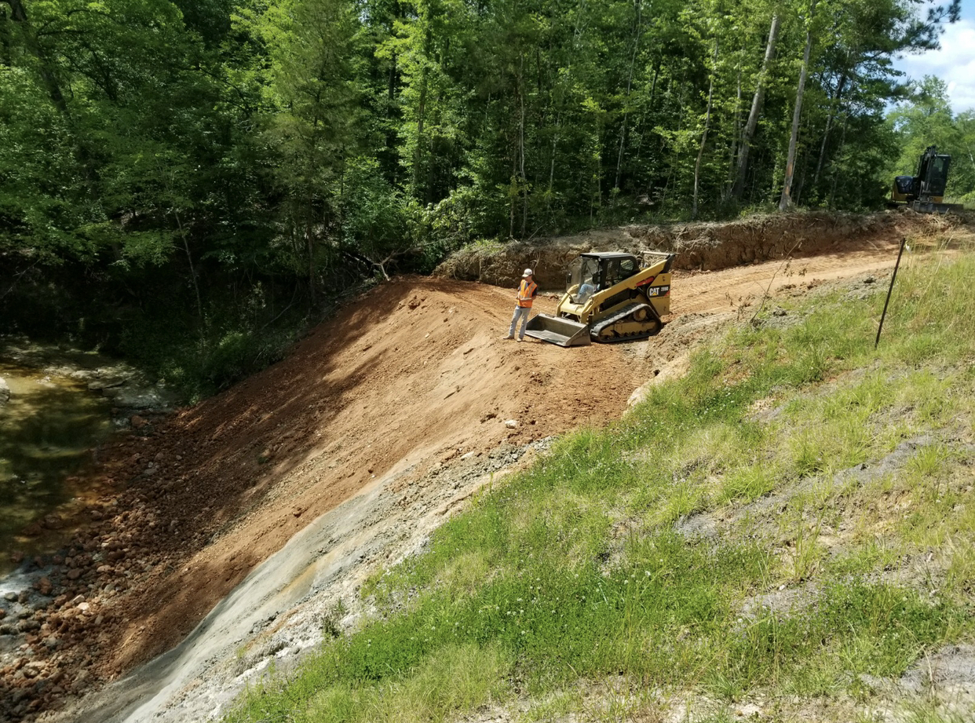
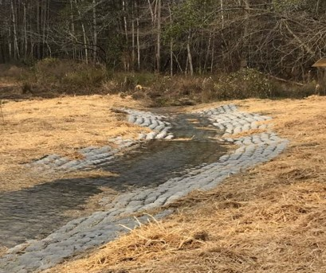
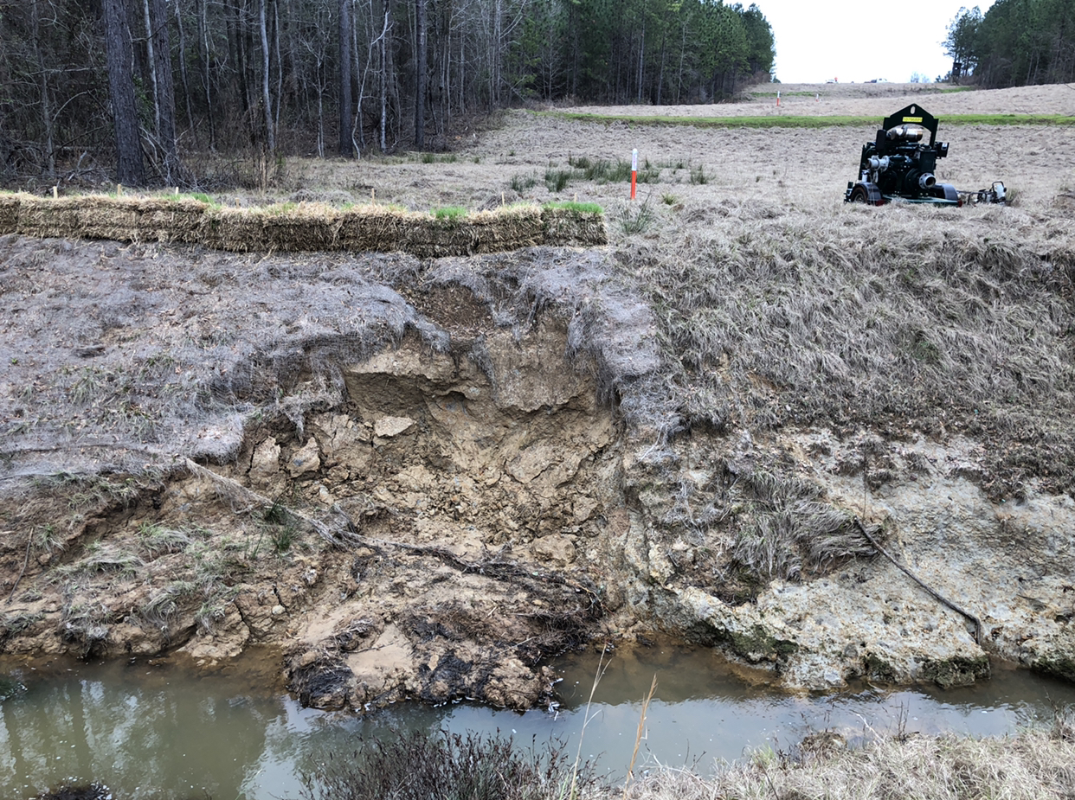
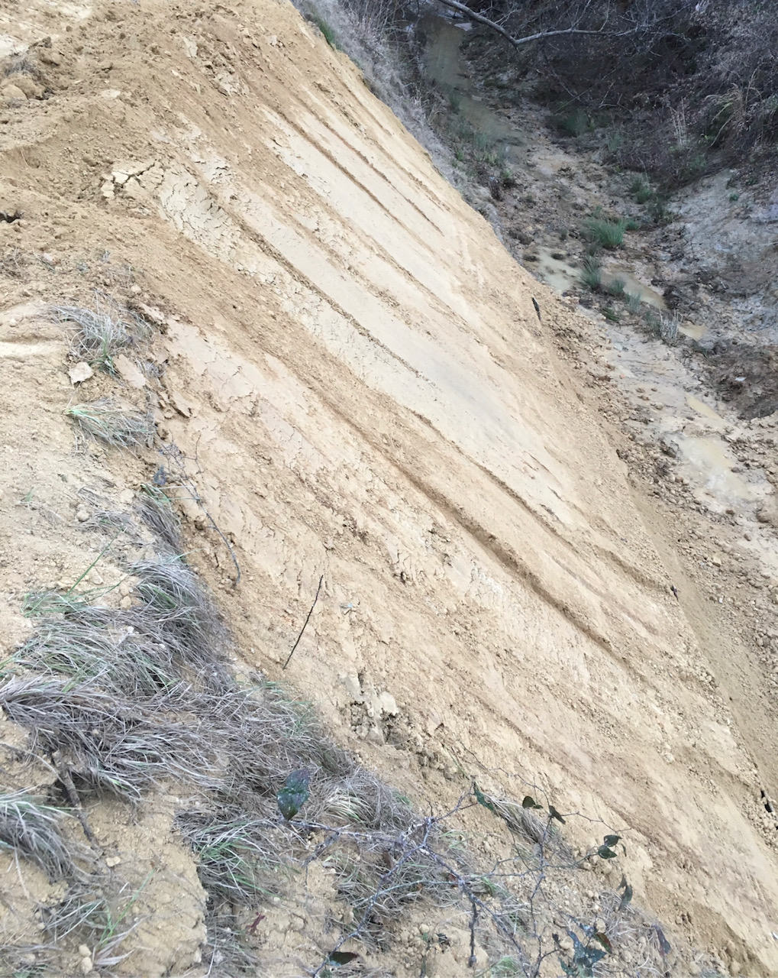
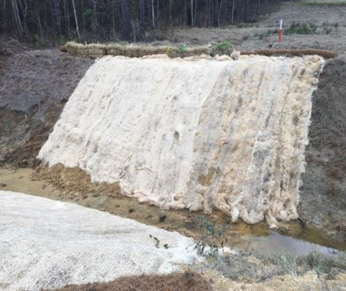
STREAMBANK REPAIR PROJECTS

Slide 8
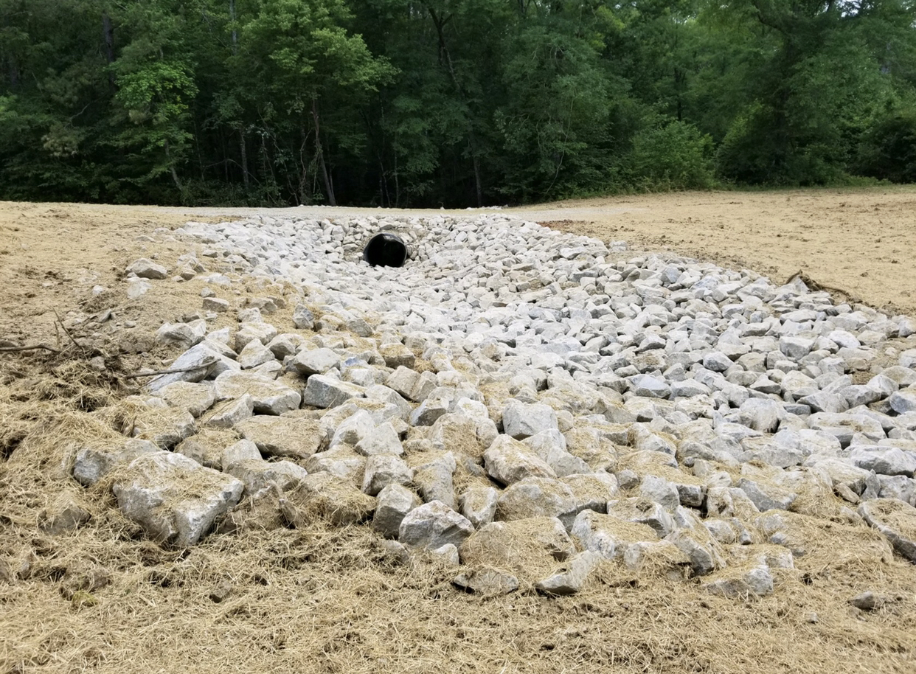
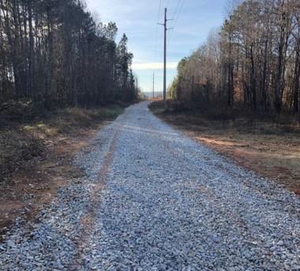
ACCESS ROAD CONTRUCTION PROJECTS

Slide 9
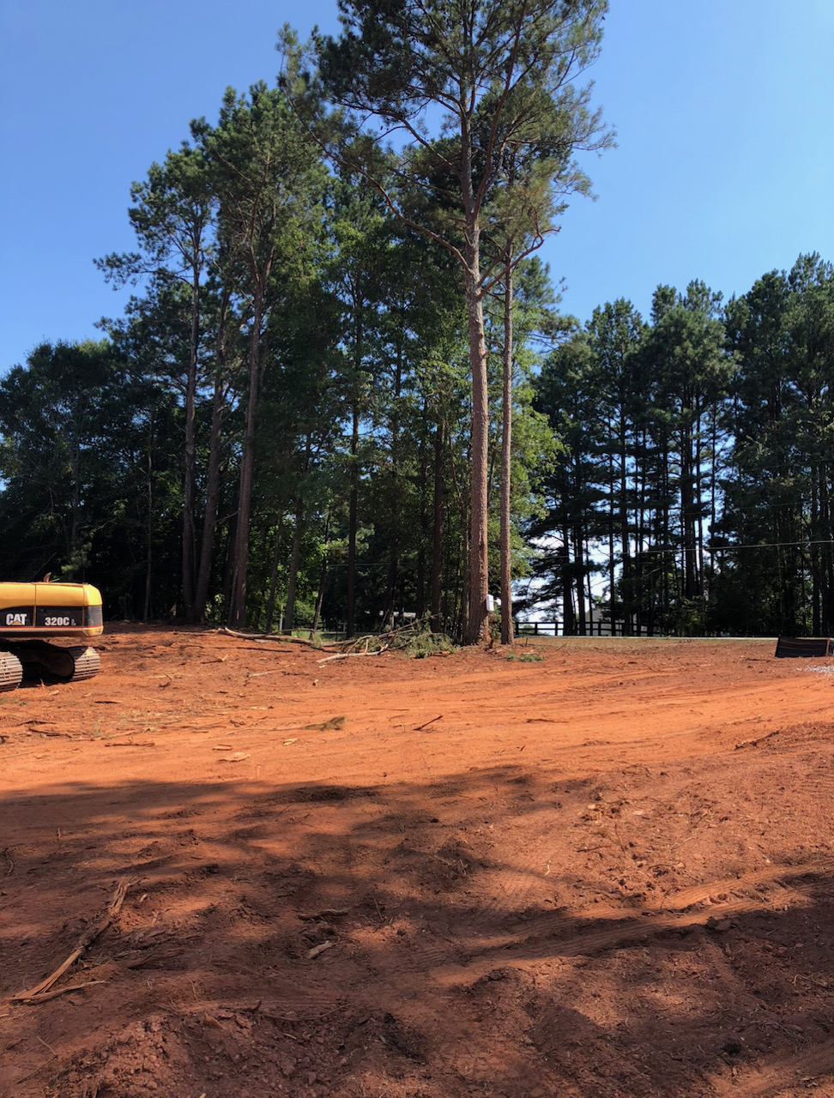
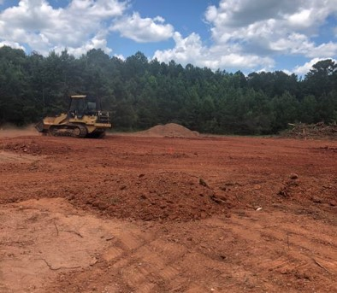
CLEARING, GRINDING AND GRUBBING PROJECTS

Slide 10
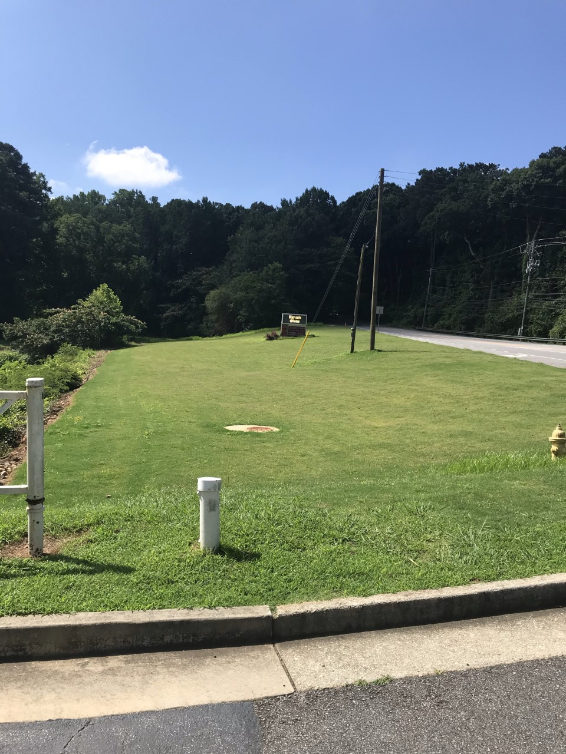
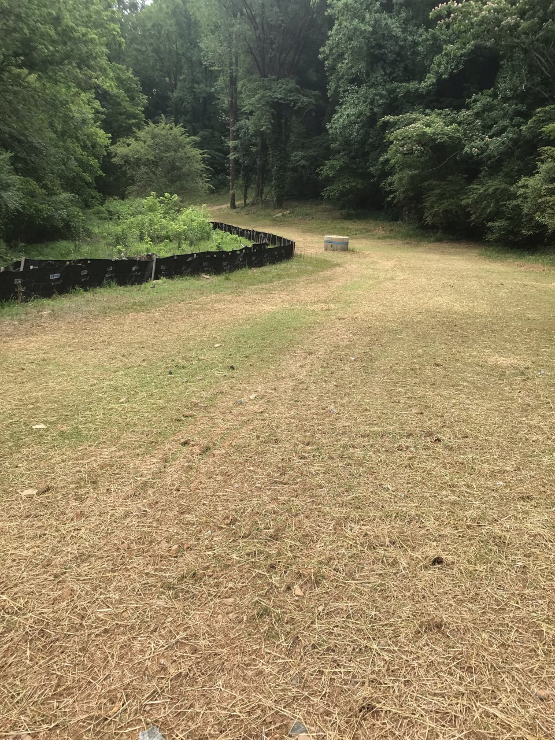
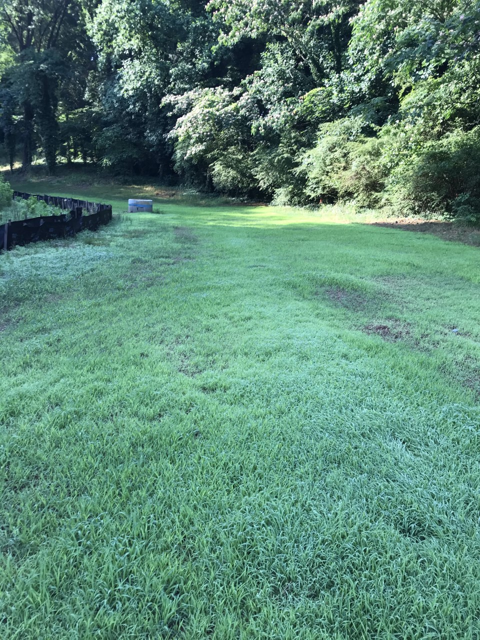
RIGHT-OF-WAY RESTORATION PROJECTS

Slide 11
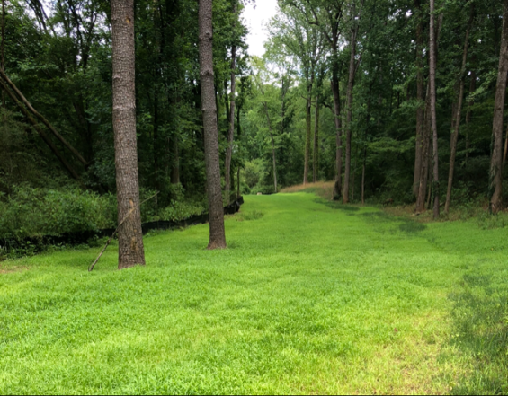
CONTACT US
We would welcome the opportunity to be a part of your team and offer our services in an effort to help make your future projects a success!
Thank you for your time!
Southeast Land Services, LLC. 678.758.6293

